Slide 1

Detecting Malicious Accounts based on Erroneous Transactions
Batch No: A-11 Project Guide:
Y.Nafiz [164G1A0557] Ms.B.Sujana,M.Tech.
C.Bushra Anjum [164G1A0516] Assistant Professor
PM.Pavani [174G5A0503]
I.Kalyan [164G1A0535]
Srinivasa Ramanujan Institute of Technology
Department of Computer Science & Engineering

Slide 2
Content
Abstract
Problem Statement
Existing System
Proposed System
Requirements
Design
Implementation
Execution
Result
References
Queries??

Slide 3
Abstract
Online social networks gradually integrate financial capabilities by enabling the usage of online money.
They serve as new platforms to host a variety of business activities such as online shopping.
Both OSNs and business partners are significantly concerned when attackers instrument a set of accounts to collect money from various accounts which are used by the registered users.By interrupting the server,unauthorized entry,bad history.

Slide 4
Problem Statement
Our work aims to design a detecting system capable of identifying malicious accounts.
To address a new problem caused by the new trend of integrating online social networks and financial activities.
To accomplish this objective by systematically integrating features that characterize accounts from perspectives including their general behaviors, and the usage of their currency.
Nevertheless,we believe our method and existing approaches can complement each other to improve the security of online social networks.

Slide 5
Existing System
Linetal. ranked the importance of fraud factors used in financial statement fraud detection, and investigated the correct classification rates of three algorithms including Logistic Regression, Decision Trees, and Artificial Neural Networks.
Throckmorton et al. proposed a corporate financial fraud detection method based on combined features of financial numbers, linguistic behavior, and non-verbal vocal.
None of existing methods is applicable to detecting malicious accounts in online promotion activities.

Slide 6
Proposed System
We have designed a system,It employs a collection of behavioral features to profile an account that participates in an online event.
These features aim to characterize an account from three aspects including 1) its general usage profile, 2) Bad history, 3)Unauthorized login.
It further integrates these features using a statistical classifier,random forest,intrusion detection so that they can be collectively used to discriminate between those accounts controlled by attrackers and benign ones.

Slide 7
Requirements
Hardware System Configuration
Hard Disk : 120 GB.
RAM : 4GB.
Processor : Intel i3
Software Requirements
Operating system : Windows 7/8/10.
Coding Language : JAVA
Tool : Netbeans 7.2.1
Database : MYSQL

Slide 8
Design
Usecase diagram
Admin
Seller
User

Slide 9
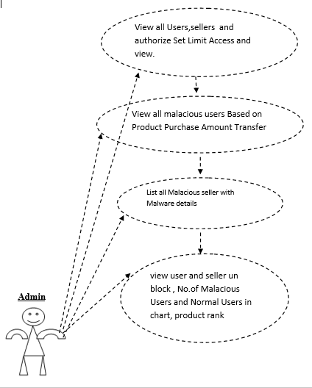
Admin

Slide 10
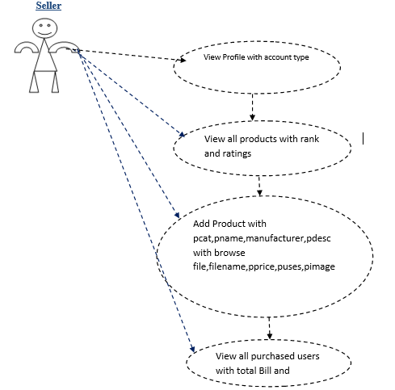
Seller

Slide 11
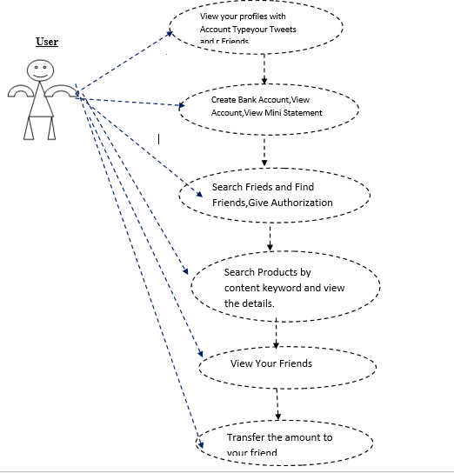
User

Slide 12
Implementation
Modules are:
Admin
Seller
User

Slide 13
Admin
In this module, the Admin has to login by using valid user name and password. After login successful he can do some operations such as:
View all users and authorize,View all Sellers and authorize.
Set Limit Access and view.
View all malicious users Based on Product, Amount Transfer.
List all Malicious seller with Malware details and mention this account holder as Spam account and block this user, view user and seller unblock request and unblock. View No.of Malicious Users and Normal Users in chart, View product rank in chart.

Slide 14
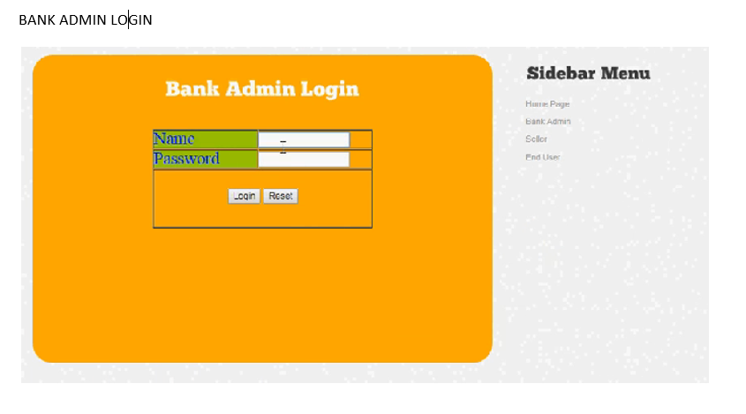
Contd…

Slide 15
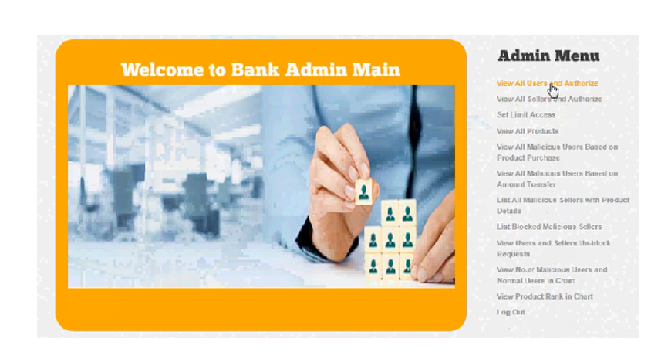
Contd…

Slide 16
Seller
In this module, there are n numbers of sellers are present. Seller should register ,After registration successful he has to wait for admin to authorize him and after admin authorized him.
Login successful he will do some operations like View Profile with account type.
Add Product with pcat,pname,manufacturer,pdesc with browse file,filename,pprice,puses,pimage
View all purchased users with total Bill and malicious users.

Slide 17
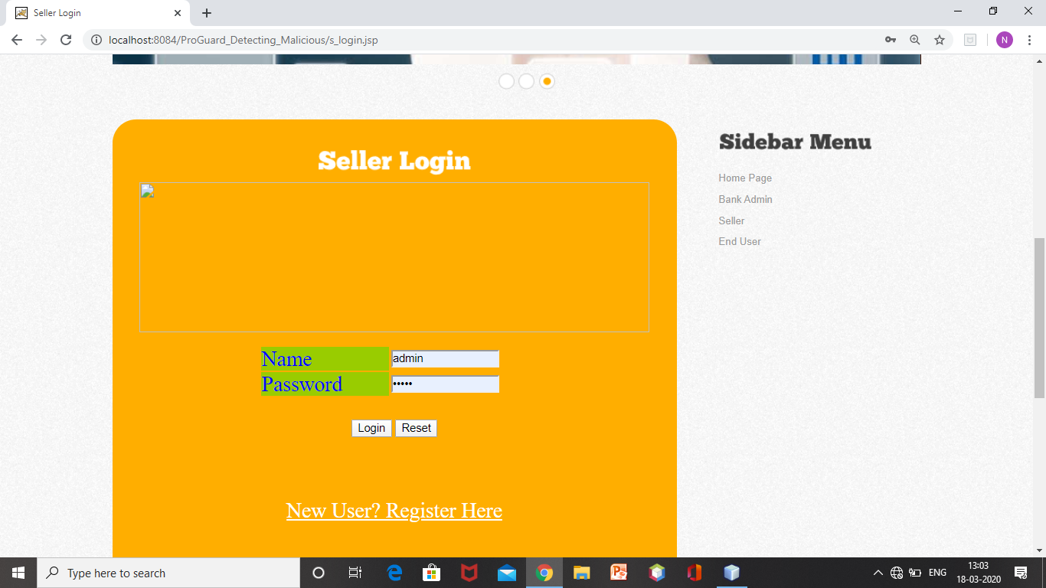
Contd..

Slide 18
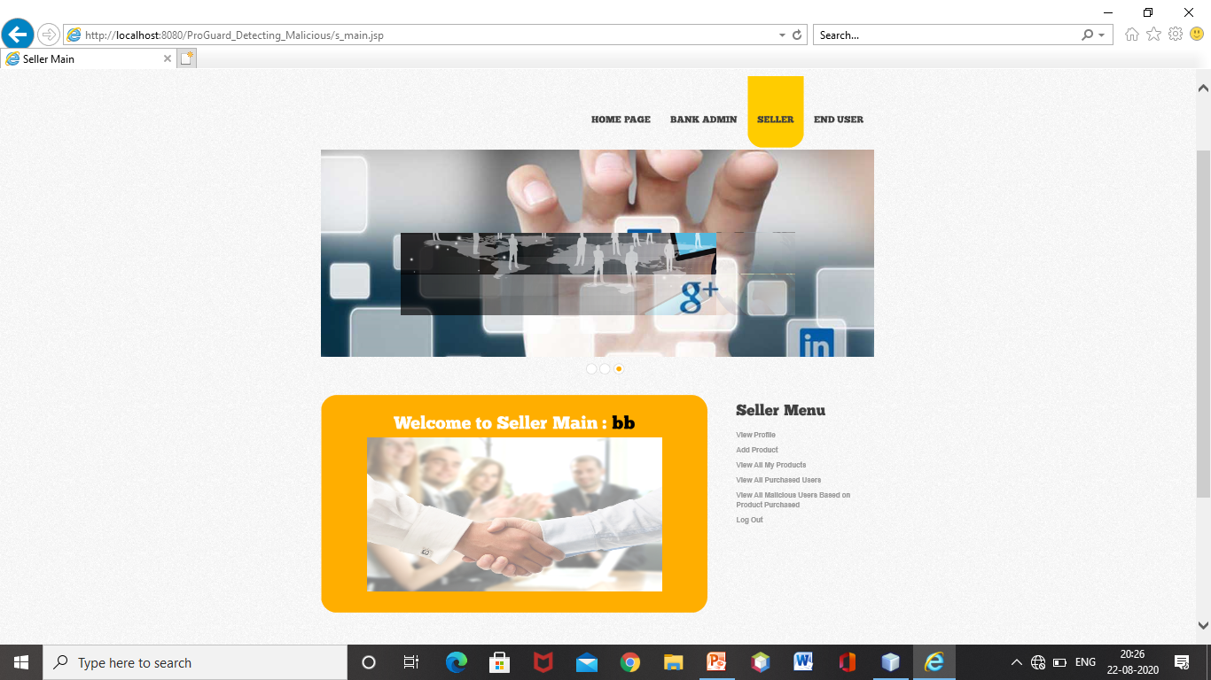
Contd..

Slide 19
User
In this module, there are n numbers of users are present. User should register.
After registration successful he has to wait for admin to authorize him and after admin authorized him.
He can login by using authorized user name and password. Login successful he will do some operations like --- Register with Location and Login and Request to un block if blocked, Create Bank Account, View Account, View Mini Statement, Search Friends and Find Friends,View Your Friends, Search Products by content keyword and view the details, purchase the product, Transfer the amount to your friend.

Slide 20
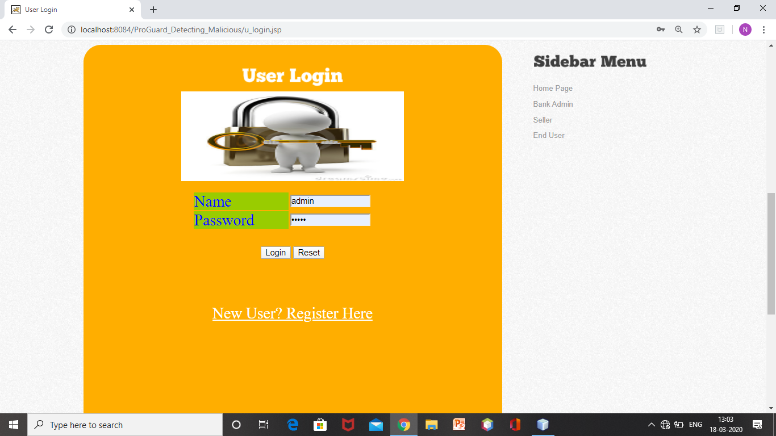
Contd…

Slide 21
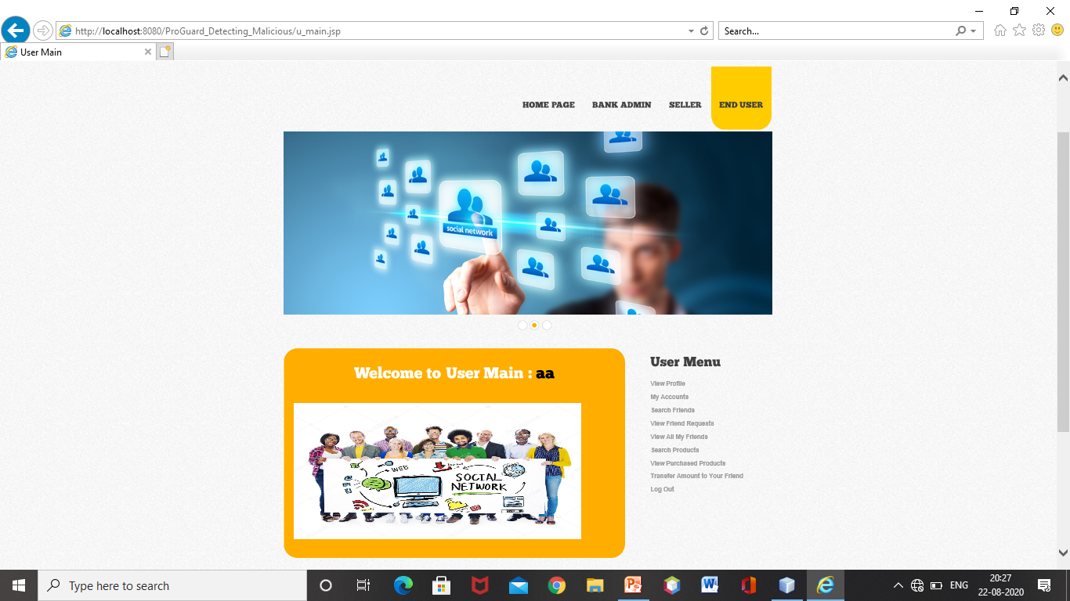
Contd..

Slide 22
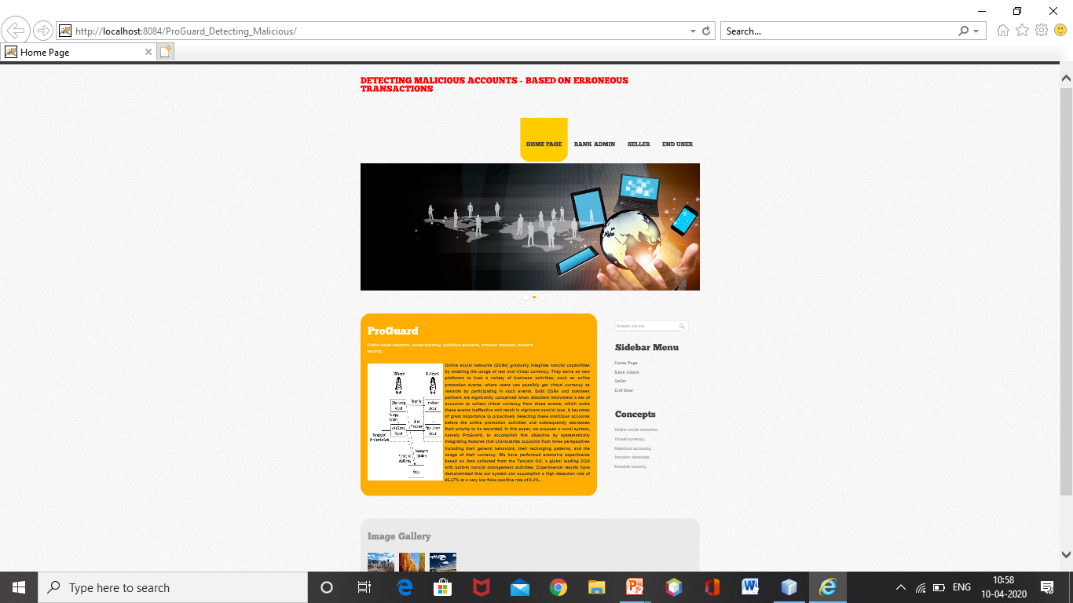
Execution
The Execution of detecting malicious the accounts based on erroneous transactions .The user interface is

Slide 23
Contd..

Slide 24
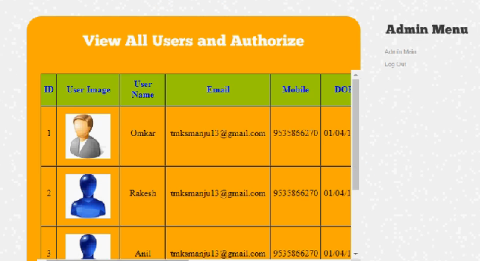
Contd..
The admin can view all the users and authorize the users

Slide 25
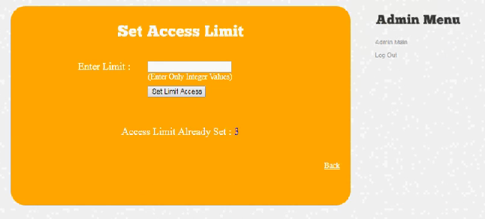
Contd..
Admin can capable to set the access limt to the users

Slide 26
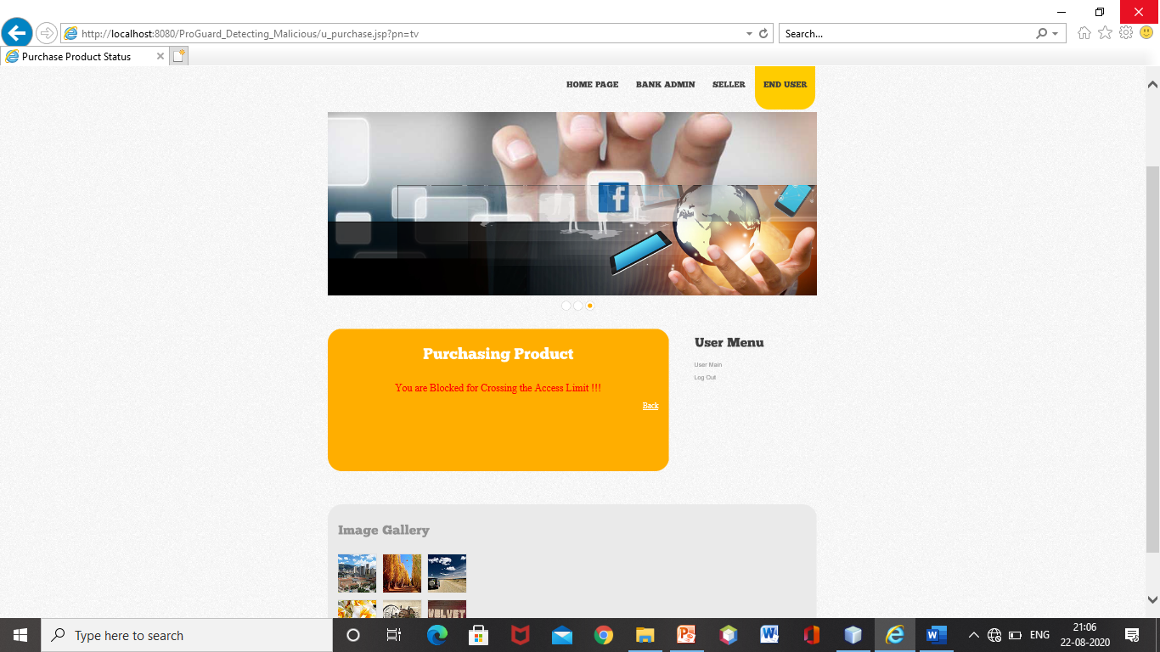
Contd..

Slide 27
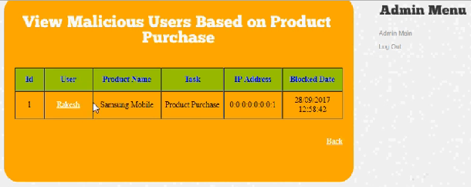
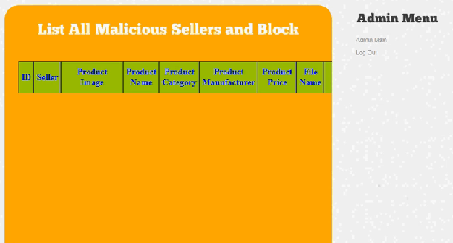
Result
Admin can be view all the malicious users based on product purchases and list all the sellers and block

Slide 28
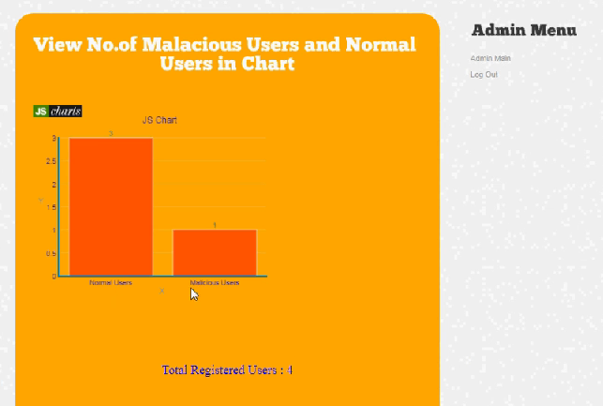
Contd..
The no.of malicious users and normal users can be viewed in the chart

Slide 29
Conclusion
Our model presents a system,to automatically detect malicious OSN accounts that participate in online promotion events. These leverages two categories of features including general behavior, and currency usage.A global leading OSN company, have demonstrated the detection accuracy which has achieved a high detection rate of 96.67% given an extremely low false positive rate of 0.3%.

Slide 30
References
[1] A. Abdallah, M. A. Maarof, and A. Zainal, ``Fraud detection system: A sur- vey,'' J. Netw. Comput. Appl., vol. 68, pp. 90_113, Oct. 2016.
[2] J.West and M. Bhattacharya, ``Intelligent _nancial fraud detection:Acomprehensive review,'' Comput. Secur., vol. 57, pp. 47_66, June.2016.
[3] C.-C. Lin, A.-A. Chiu, S.Y. Huang, and D. C.Yen, ``Detecting the _nancial statement fraud: The analysis of the differences between data mining techniques and experts' judgments,'' Knowl.-Based Syst., vol. 89, pp. 459_ 470, Sep. 2015.

Slide 31
GITHUB URL
https://github.com/nafizyadiki786/Detecting-
Malicious-accounts-based-on-erroneous- Transactions

Slide 32
Thank you
Queries
?

